Slide 1
T-Test, Chisquare Test ANNOVA TEST

Slide 2
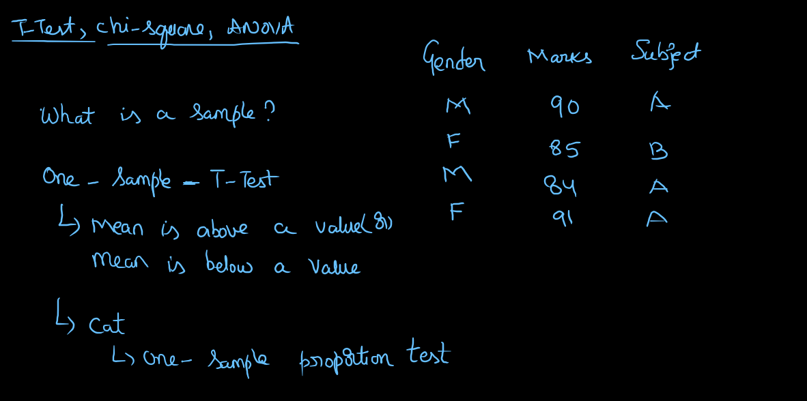

Slide 3
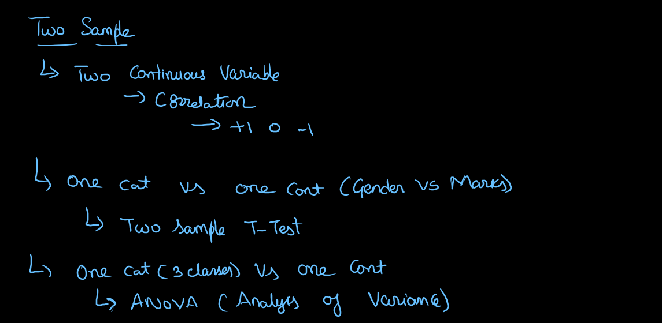

Slide 4
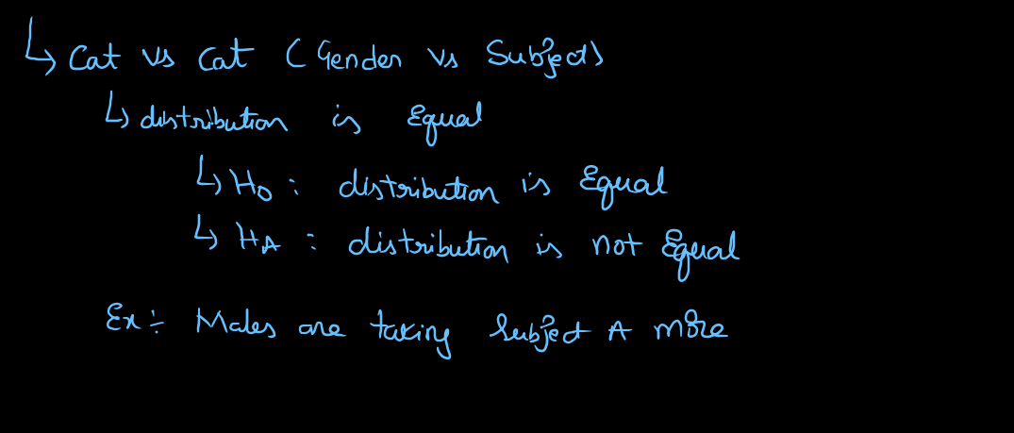

Slide 5
